Slide 1
22AIE301 PROBABILISTIC REASONING — FINAL PROJECT REVIEW
[Explainable Bayesian Network for Probabilistic Crop Risk Assessment Under Environmental Uncertainty]
Track Declaration (Check One): [ ] Track I: Industry Product & Verification | [ ] Track II: Journal/Conference Paper (Q2/Scopus)
Group Details & Team Members:
• Group No: [C-13]
• Member 1: [Bhadresh RP & CB.SC.U4AIE24208] (Presenter Segment: Minutes 5–10)
• Member 2: [CH. Priya madhav & CB.SC.U4AIE24211 (Presenter Segment: Minutes 5–10)
• Member 3: [B.Cibi kumar & CB.SC.U4AIE24212] (Presenter Segment: Minutes 5–10)
Member 4: [G.Rishi kanth & CB.SC.U4AIE24218] (Presenter Segment: Minutes 5–10)
• Mentor : Dr.Navaneeth Haridasan

Slide 2
22AIE301 PROBABILISTIC REASONING — FINAL PROJECT REVIEW
1. Problem Statement, Industry/Research Scope & Objectives
Problem Statement & Context
Environmental Uncertainty : Crop production is affected by uncertain environmental factors such as rainfall, temperature, humidity, soil moisture.
Uncertain Risk Prediction : Traditional crop assessment methods may not effectively represent the probabilistic relationships between environmental conditions.
• Project Scope: To develop an explainable Bayesian Network that predicts crop risks under uncertain environmental conditions and supports farmers in making informed agricultural decisions.
Core Project Objectives (3–4 Enumerated)
• Objective 1(Develop a Bayesian Network) : Build a probabilistic Bayesian Network that models the relationships between environmental variables and crop risk factors.
• Objective 2 (Estimate Crop Risk Probabilities):
Estimate posterior probabilities for the 22 crop classes under different environmental conditions using Bayesian inference.
• Objective 3 (Provide Explainable Predictions): Identify and explain the environmental factors that contribute most to the predicted crop risk using probabilistic reasoning and conditional dependencies.
• Objective 4 (Support Agricultural Decision-Making): farmers choose appropriate preventive measures and improve crop management under uncertainity.
22AIE301 Course Project Final Review Template | Slide 2 of 10

Slide 3
22AIE301 PROBABILISTIC REASONING — FINAL PROJECT REVIEW
2. Probabilistic Model Formulation (PGM Architecture)
PGM Graph Structure
• Selected PGM Framework:
Bayesian Network (DAG)
• Continuous features are discretized into Low, Medium and High states.
Structure learning: Hill Climbing with BDeu scoring and a constraint preventing edges from the crop label to environmental features.
Input variables : Nitrogen, phosphorus, potassium, temperature, humidity, soil pH and rainfall.
Target variable: Crop label with 22 classes.
Joint Probability Factorization
• Joint Distribution Equation:
P(X_1, ..., X_n) = ∏ P(X_i | Parents(X_i))
• Each node has a conditional probability distribution given its parent nodes.
• Parameters are learned using Bayesian estimation with a Dirichlet prior.
Uncertainty Mechanics
• Sources of Uncertainty:
Unpredictable rainfall, temparature fluctuations and crop label data.
• Modeling Rationale:Traditional deterministic models may produce fixed predictions without adequately representing uncertainty.
• Expected Output: Generate a posterior probability distribution under observed environmental conditions,
22AIE301 Course Project Final Review Template | Slide 3 of 10

Slide 4
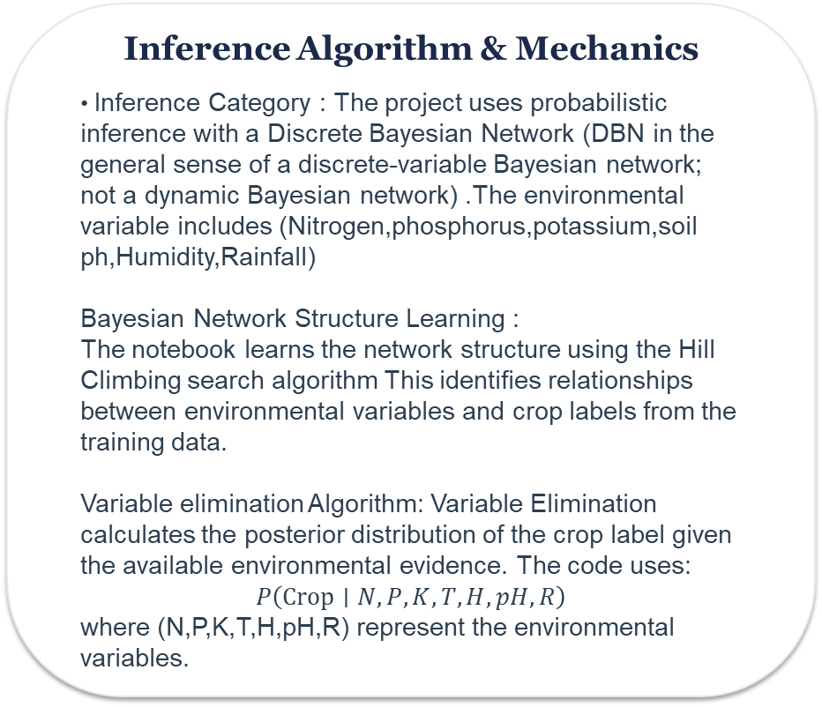
22AIE301 PROBABILISTIC REASONING — FINAL PROJECT REVIEW
3. Inference & Decision Engine Mechanics
Inference Algorithm & Mechanics
• Inference Category : The project uses probabilistic inference with a Discrete Bayesian Network (DBN in the general sense of a discrete-variable Bayesian network; not a dynamic Bayesian network) .The environmental variable includes (Nitrogen,phosphorus,potassium,soil ph,Humidity,Rainfall)
Bayesian Network Structure Learning :
The notebook learns the network structure using the Hill Climbing search algorithm This identifies relationships between environmental variables and crop labels from the training data.
Variable elimination Algorithm: Variable Elimination calculates the posterior distribution of the crop label given the available environmental evidence. The code uses:
$$P\left(\text{Crop}∣N,P,K,T,H,pH,R\right)$$
where (N,P,K,T,H,pH,R) represent the environmental variables.
Decision Analysis & Interventional Scenarios
•Model Evaluation :
Accuracy: The proportion of test samples classified correctly.
Weighted F1-score: The F1-score averaged according to the number of samples in each class.
Confusion matrix: A visualization of correct and incorrect crop predictions.
Per-crop F1-score plot: A comparison of predictive performance across crop classes.
22AIE301 Course Project Final Review Template | Slide 4 of 10

Slide 5
22AIE301 PROBABILISTIC REASONING — FINAL PROJECT REVIEW
4. System Architecture, Computational Tools & AI Integration
Software Toolstack & Implementation
Data Processing and Numerical Computation:
Pandas
NumPy
CSV dataset
Matplotlib
Seaborn
scikit-learn metric
Combining PGMs with Modern AI / ML
probabilistic predictions: Provides probabilities for crop classes rather than only a single predicted label.
2. Learned dependencies: Discovers network relationships from training data.
3. Model evaluation: Uses established classification metrics to assess predictive performance.
4. Interpretability: Exposes the network structure, posterior probabilities, and feature-sensitivity results.
22AIE301 Course Project Final Review Template | Slide 5 of 10

Slide 6
22AIE301 PROBABILISTIC REASONING — FINAL PROJECT REVIEW
5. Core Artifact Demonstration & Performance Visuals
Key Metrics & Insights
• Prediction outcome: Evaluate the model using accuracy,F1-score, when labelled crop label data is available.Test samples=440 , - Accuracy: 75.68%- Macro F1-score: 0.73- Weighted F1-score: 0.73
• Normalized entropy: Low = 0.5858, Medium = 0.6682, High = 0.4407.
Feature sensitivity measures changes in crop probability distributions under different feature states.
Primary Visual Evidence / Demonstration
The project visualizes the learned Bayesian Network using NetworkX and Matplotlib. The graph displays environmental variables such as nitrogen, phosphorus, potassium, temperature, humidity, soil pH, and rainfall, along with the crop label.
The Bayesian inference engine calculates posterior probabilities for different crop classes based on the supplied environmental evidence.
A bar chart titled “Effect of Rainfall Scenarios on Crop Probability” displays the posterior probabilities of pigeonpeas and blackgram across the three rainfall conditions.
22AIE301 Course Project Final Review Template | Slide 6 of 10

Slide 7
22AIE301 PROBABILISTIC REASONING — FINAL PROJECT REVIEW
6. Verification, Experimental Validation & Progress Tracking
Verification & Validation Methodology
• Track II Validation: a stratified 80/20 train-test split, test-set classification metrics, confusion matrix and scenario-based probability analysis.
Progress vs Objectives & Timeline
• Achievement Matrix against Objectives (from Slide 2):
- Obj 1 (Bayesian Network Modeling): [implemented]
- Obj 2 (Inference Engine): [ implemented]
- Obj 3 (Implementation): [Completed]
- Obj 4 (Validation/Paper): [Under implementation]
22AIE301 Course Project Final Review Template | Slide 7 of 10

Slide 8
DESIGNATED CREDIT ALLOCATION SLIDE — 2.0 MARKS OUT OF 10
7. Final Track Deliverable & Assessment Proof (Slide 8)
TRACK SELECTION DECLARATION (CHECK ONE):
[ ] TRACK I: INDUSTRY PRODUCT & VERIFICATION | [ ] TRACK II: JOURNAL / CONFERENCE PAPER
TRACK I: INDUSTRY PRODUCT PROOF
• Proof 1: Demonstrate the user interface where users enter environmental parameters and select a crop.
Explainability Visualization: Show how changes in rainfall, temperature, or soil moisture influence the final crop risk prediction.
TRACK II: PUBLICATION PAPER PROOF
• Proof 2: Display Bayesian Network graphs showing the relationships between environmental factors, crop stress, pest risk, and crop damage probability.
.
Prediction Output: Present the predicted crop risk probability using a risk score, probability chart, or color-coded dashboard.
22AIE301 Course Project Final Review Template | Slide 8 of 10

Slide 9
22AIE301 PROBABILISTIC REASONING — FINAL PROJECT REVIEW
8. Conclusion, Repository Deliverables & Future Scope
Key Technical Contributions & Summary
• Summary of Work Completed: Development of an Explainable Bayesian Network framework to assess crop recommendation under uncertain environmental conditions. The system models relationships between rainfall, temperature, humidity.
• Primary Technical Deliverables:
- Construction of a Bayesian Network representing environmental factors and crop risk.
- Implemented a Bayesian Network for probabilistic crop recommendation, with learned dependencies, posterior crop probabilities, rainfall scenario analysis and environmental-feature sensitivity analysis.
Repository Status & Future Scope
• Future Scope & Scaling Extensions:
-Integration of Real-Time Weather Data
- Incorporate observed crop-failure and yield-loss data for direct risk estimation.
-Integration with Modern Machine Learning Models
- Improved Explainability and Causal Analysis
22AIE301 Course Project Final Review Template | Slide 9 of 10

Slide 10
22AIE301 PROBABILISTIC REASONING — FINAL PROJECT REVIEW
9. Digitally Verifiable Literature & Software References
Academic & Technical Citations
1.Predicting rice crop yield using Bayesian networks , Author: Niketa Gandhi, Leisa J. Armstrong, Owaiz Petkar - [2016]
2.A Bayesian network for predicting yield response of winter wheat ,Author : F. Tari – [1996]
3.Embedding expert opinion in a Bayesian network model to predict wheat yield from spring wheather , Author : Niketa Gandhi, Leisa J. Armstrong, Owaiz Petkar – [2023]
4. Corn yield prediction and uncertainty analysis based on remotely sensed variables using a Bayesian neural network approach , Author - Yuchi Ma, Zhou Zhang, Yanghui Kang, Mutlu Özdoğan – [2021]
5. Crop yield prediction via explainable AI and interpretable machine learning: Dangers of black box models for evaluating climate change impacts on crop yield Author-name - Zhou Zhang, Yanghui Kang - [2023]
6. Bayesian Multi-modeling of Deep Neural Nets for Probabilistic Crop Yield Prediction M. Yeasin, K. N. Singh, A. Lama, B. Gurung – [2021]
7. Modelling faba bean production in an uncertain future climate Author - M. Yeasin, K. N. Singh, A. Lama, B. Gurung – [2022]
22AIE301 Course Project Final Review Template | Slide 10 of 10

